Slide 1
Presentation on Network Topologies
Presented By :Said Ahammad
ID NO.:1200812
Bach Id :ID_NT/ACSL-01M/R28/01
Student of Network Technology
Round-28 IDB BISEW
Submitted to
Mir Akbar Hossain
Sir

Slide 2
What is a network topology?
In communication networks, a topology is a usually schematic description of the arrangement of a network, including its nodes and connecting lines. There are two ways of defining network geometry: the physical topology and the logical (or signal) topology.

Slide 3
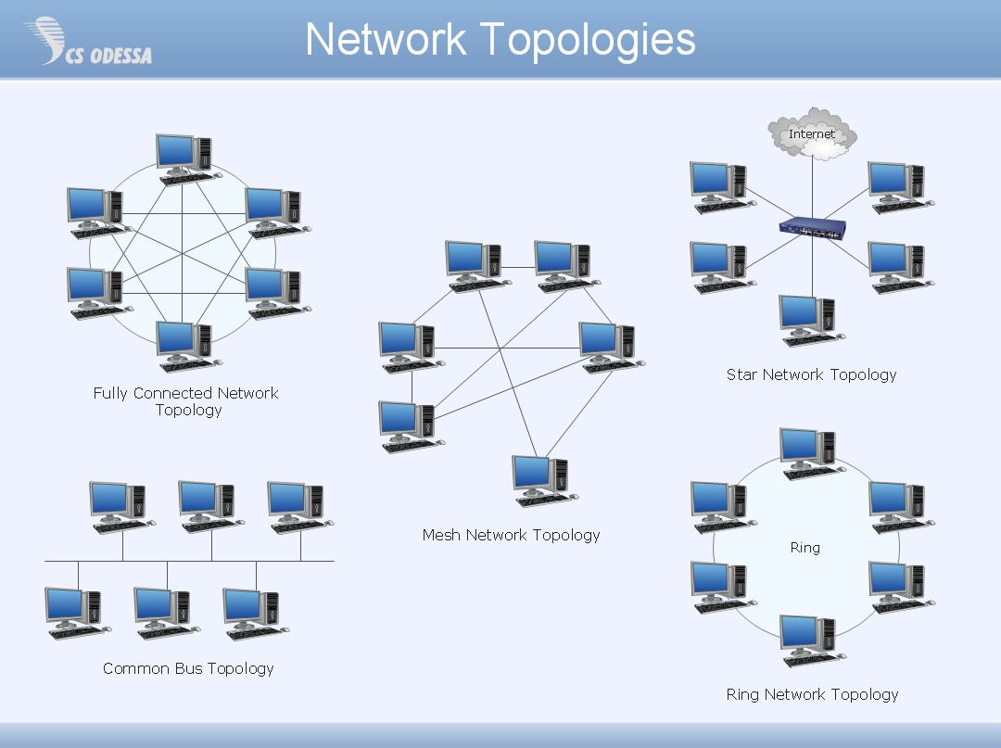

Slide 4
BUS Topology
Bus topology is a network type in where every computer and network device is connected to single cable

Slide 5
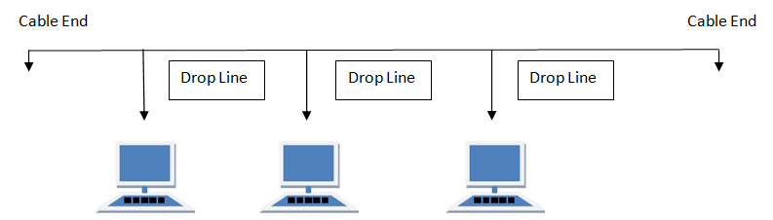
The picture of Bus Topology

Slide 6
Features of Bus Topology
1. It transmits data only in one direction.
2. Every device is connected to a single cable

Slide 7
Advantages of Bus Topology
It is cost effective.
Cable required is least compared to other network topology.
Used in small networks.
It is easy to understand.
Easy to expand joining two cables together

Slide 8
Disadvantages of Bus Topology
Cables fails then whole network fails.
If network traffic is heavy or nodes are more the performance of the network decreases.
Cable has a limited length.
It is slower than the ring topology.

Slide 9
The End Thanks All For Watching

